Slide 1

ADHOC NETWORK TECH COMPANY
REVIEW- 2

Slide 2
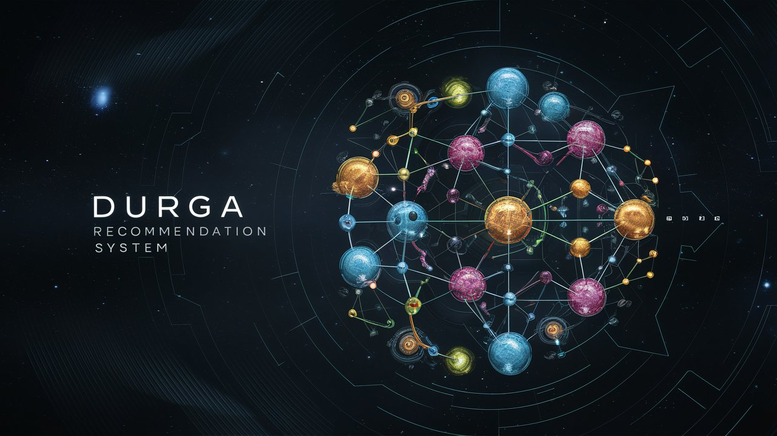
DRUG RECOMMENDATION SYSTEM
Using Machine Learning with Python

Slide 3


ABSTRACTION
In the realm of healthcare, timely and accurate drug recommendations during medical emergencies can significantly impact patient outcomes. This project presents a robust "Drug Recommendation System in Medical Emergencies using Machine Learning," implemented in Python. The system leverages two powerful classification algorithms, namely the Random Forest Classifier and the Decision Tree Classifier, attaining remarkable accuracies of 100% on both training and test datasets.

Slide 4


WORKING
The algorithm prioritizes medications with high sentiment ratings, considering potential side effects and issues from unfavorable reviews.
The Drug Recommender System uses a test dataset with user preferences and comments to assess performance, including precision, recall, accuracy, and F1-score.
A recommendation system is an artificial intelligence or AI algorithm, usually associated with machine learning, that uses Big Data to suggest or recommend additional products to consumers.

Slide 5
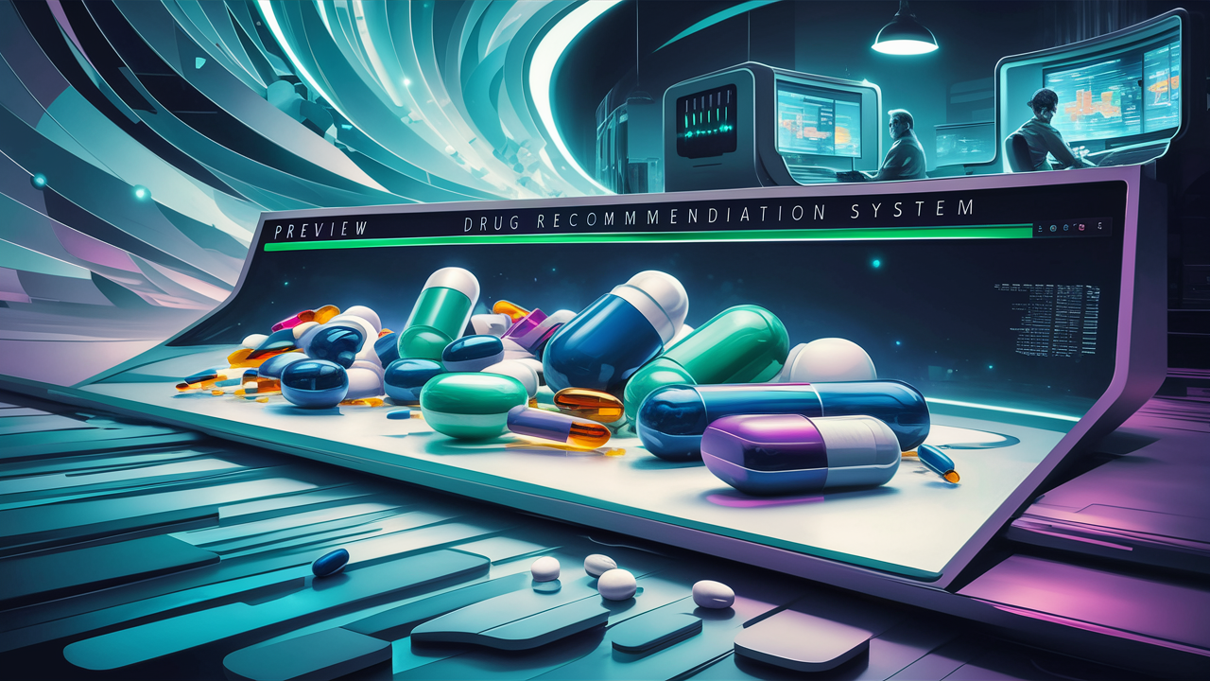

INTRODUCTION
The rapid increase in coronavirus cases has led to a doctor shortage,
especially those in rural areas. it difficult to address the shortage
quickly. In this challenging period, activating telemedicine is crucial.
Medication errors are prevalent, causing harm to thousands of people
each year. Due to limited information, doctors often prescribe the
wrong medication, resulting in a 40% error rate. Selecting the best
prescription is challenging as new research and medications emerge

Slide 6

Challenges in the Existing Healthcare Information System
CONCLUSION
One of the primary challenges of the existing system is the wide variation in the reliability and accuracy of information available online.
Additionally, the lack of personalization in recommendations often leads to generic advice that fails to consider individual health parameters.
Privacy concerns further compound these challenges, as users may be hesitant to share sensitive health information on online platforms.
Moreover, the absence of a systematic approach to leveraging advanced technologies like Machine Learning leaves a gap in delivering accurate and tailored medical suggestions.
During emergencies such as pandemics or natural disasters, the existing system may struggle to provide timely and reliable information, exacerbating the need for a more robust solution.
Machine learning algorithms analyse large-scale patient data, electronic health records, drug
properties, and domain knowledge to generate accurate and tailored drug recommendations. These
systes leverage patient similarities, drug attributes, historical data, and complex patterns to
provide personalized suggestions, considering factors such as drug efficacy, safety, and patientspecific characteristics.

Slide 7

PROPOSED SYSTEM
CONCLUSION
Our system integrates advanced Machine Learning algorithms for precise medication recommendations.
Decision trees ensure reliable insights, even in critical medical scenarios.
Privacy measures provides secure handling of sensitive health data.
Users receive personalized medication insights based on individual health parameters.
Our system delivers timely responses during emergencies, providing swift healthcare advice.
Machine learning algorithms analyse large-scale patient data, electronic health records, drug
properties, and domain knowledge to generate accurate and tailored drug recommendations. These
systes leverage patient similarities, drug attributes, historical data, and complex patterns to
provide personalized suggestions, considering factors such as drug efficacy, safety, and patientspecific characteristics.

Slide 8


CONCLUSION
An simple interface enhances user experience and easy access to medical suggestions.
Continuous learning mechanisms adapt to evolving medical knowledge and user feedback.
Multi-platform accessibility ensures users can seek advice anytime, anywhere.
Transparent algorithms build trust by revealing the technology behind medical suggestions.
Machine learning algorithms analyse large-scale patient data, electronic health records, drug
properties, and domain knowledge to generate accurate and tailored drug recommendations. These
systes leverage patient similarities, drug attributes, historical data, and complex patterns to
provide personalized suggestions, considering factors such as drug efficacy, safety, and patientspecific characteristics.

Slide 9
SYSTEM REQUIREMENTS
Hardware :
System : Pentium i3 Processor.
Hard Disk : 500 GB.
Monitor : 15’’ LED.
Input Devices : Keyboard, Mouse.
Ram : 8 G
Software :
Operating system : Windows 10 / 11.
Coding Language : Python 3.10.9.
Web Framework : Flask.
Frontend : HTML, CSS, JavaScript.

Slide 10
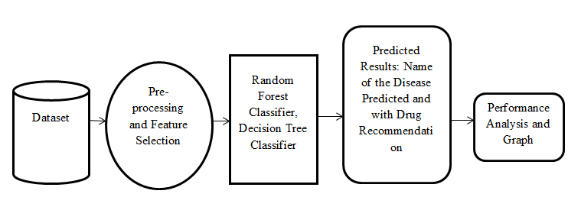
SYSTEM ARCHITECTURE

Slide 11

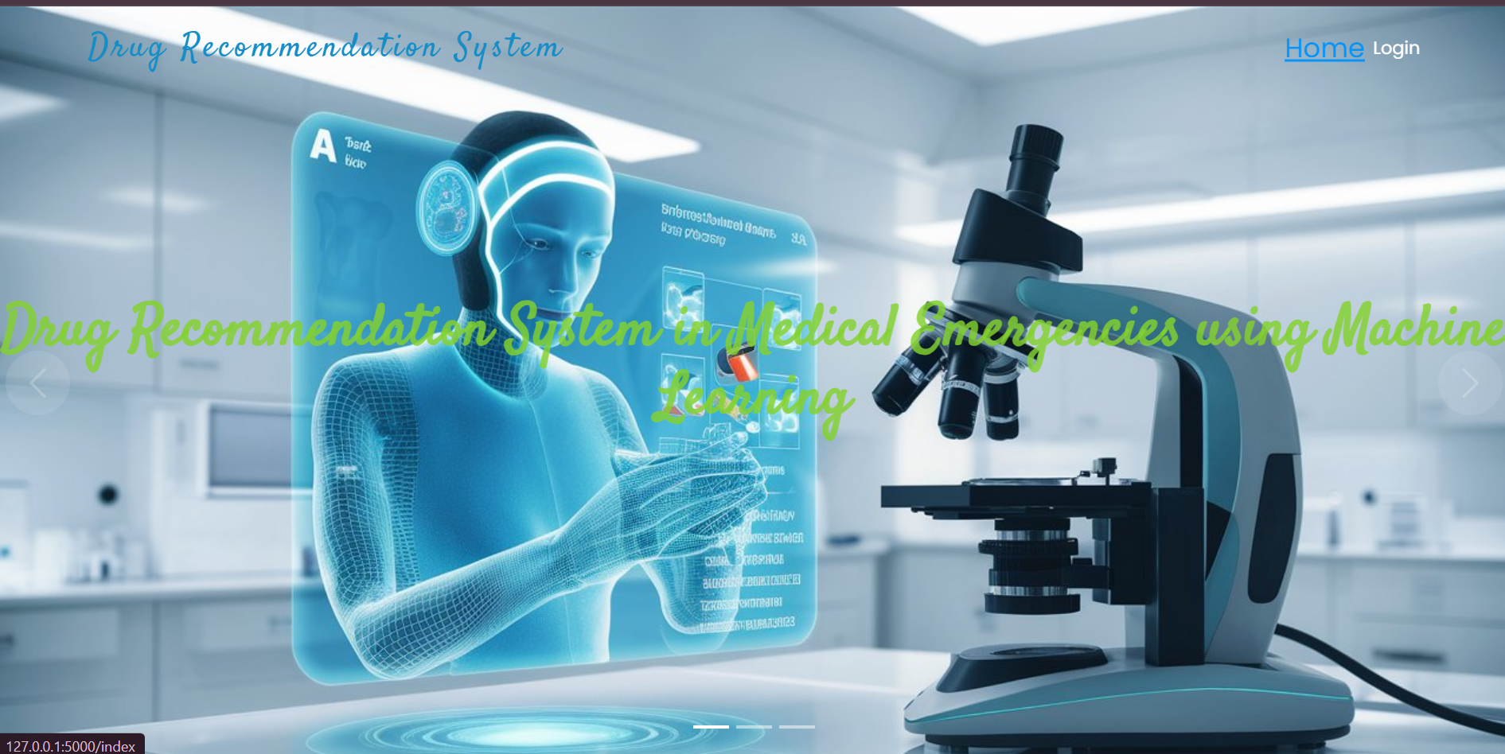
DESIGN AND IMPLEMENTATION
HOME

Slide 12


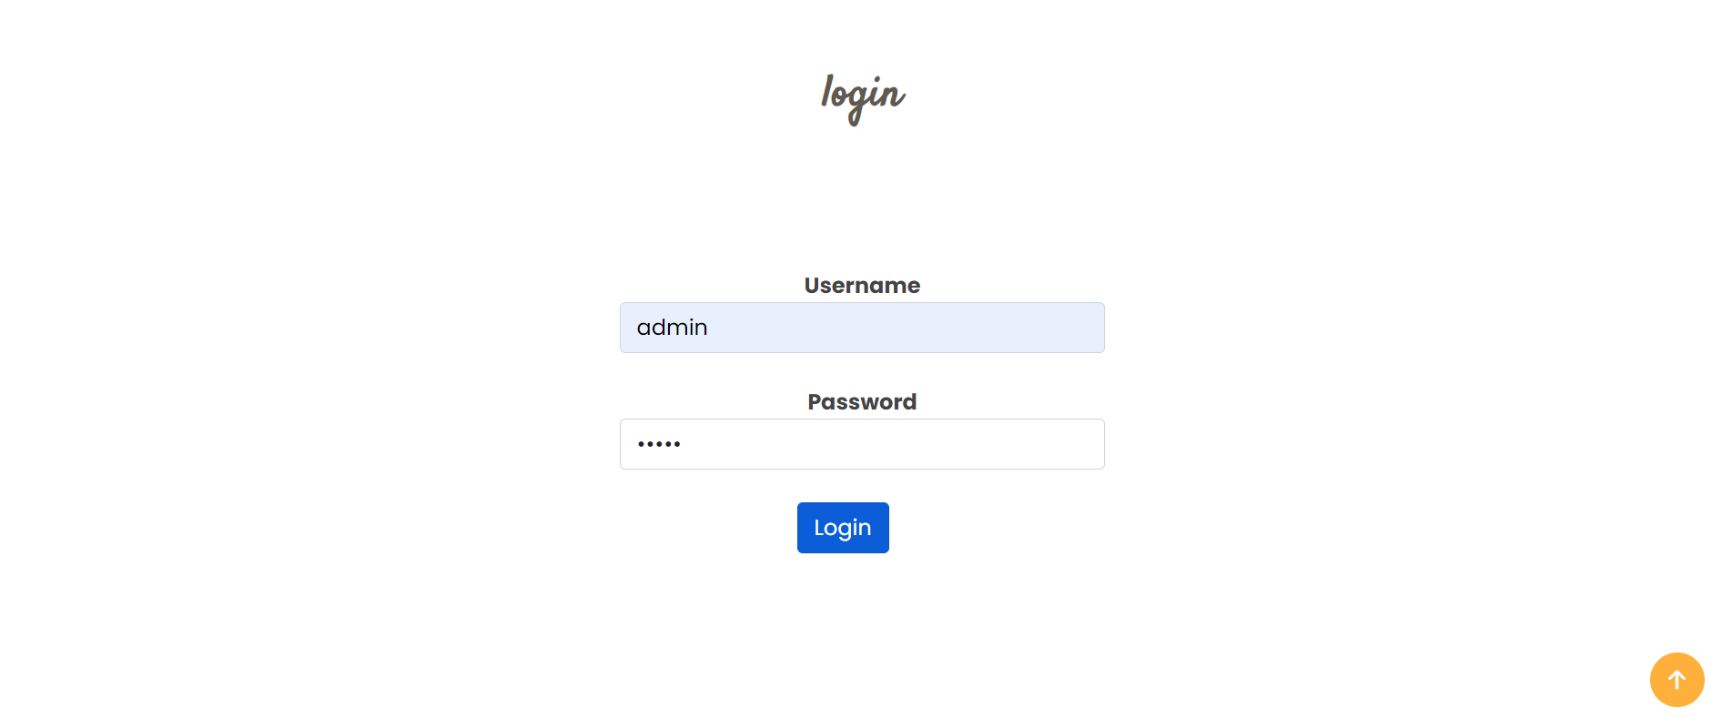
LOGIN

Slide 13
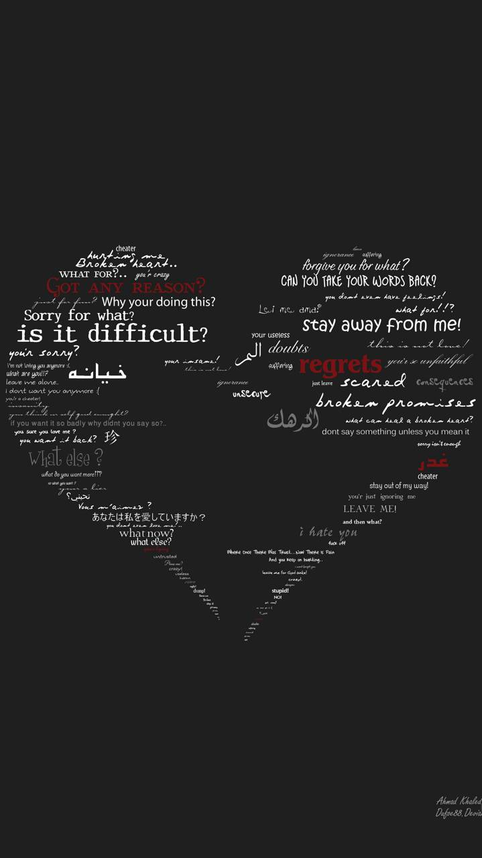
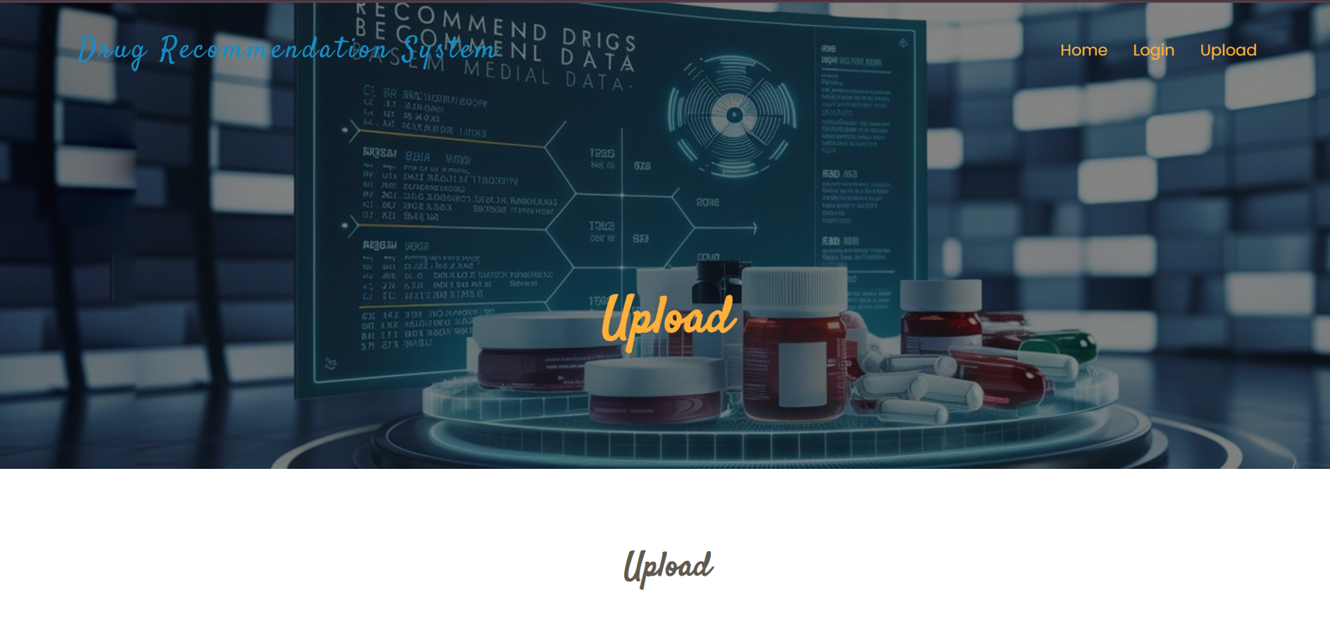

UPLOAD

Slide 14
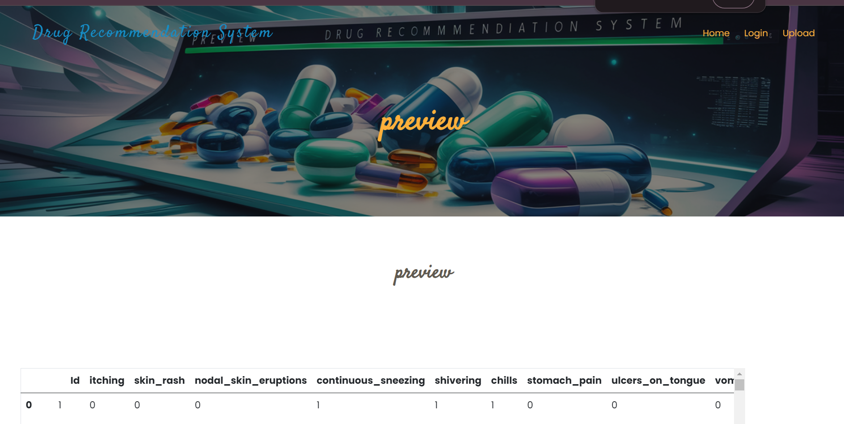

Slide 15
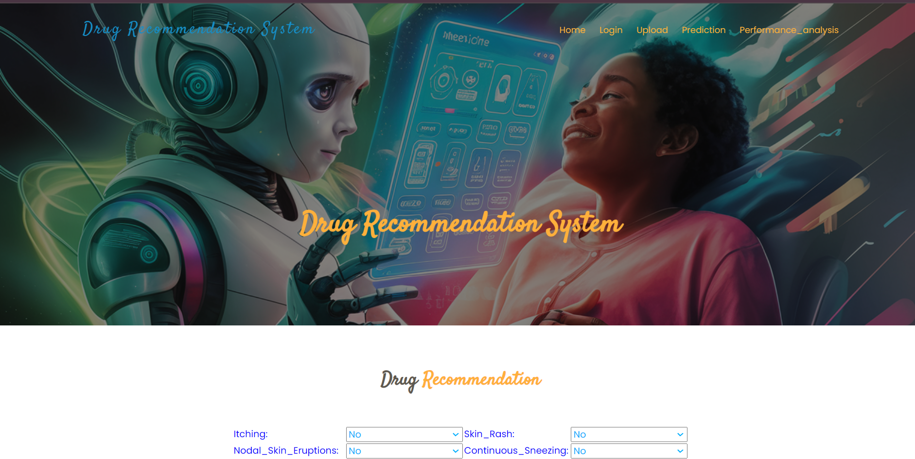

Slide 16
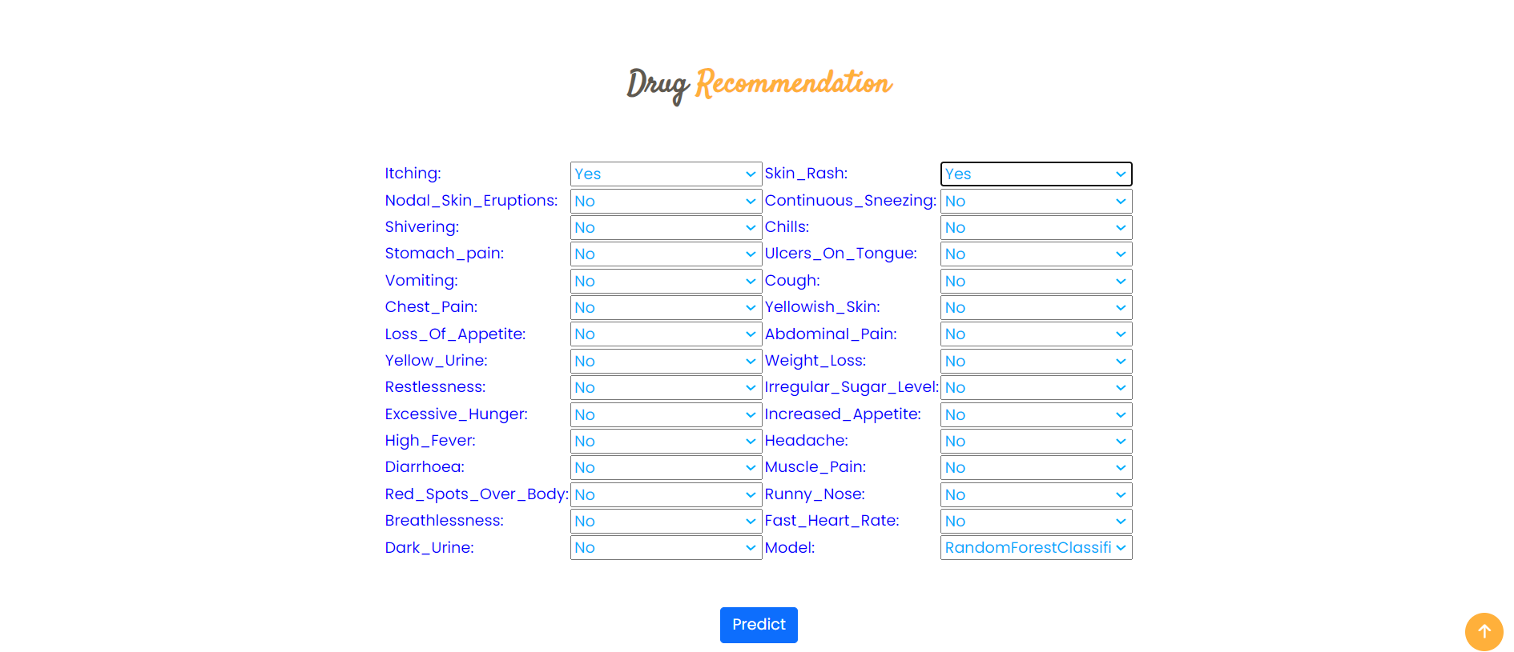


Slide 17
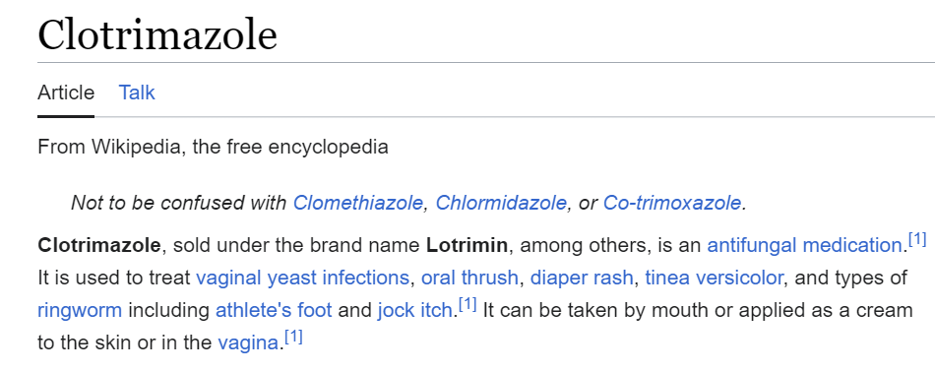


Slide 18


conclusion
In conclusion, the development and evolution of the Drug Recommendation System in Medical Emergencies using Machine Learning mark a significant stride towards enhancing the efficiency and precision of drug recommendations during critical healthcare scenarios. The project commenced with an examination of the limitations of the existing system, which primarily relied on the Decision Tree classification algorithm, achieved 99% accuracy, and operated with a limited set of drug classes and features.
The proposed system represents a transformative enhancement, addressing the shortcomings of the earlier iteration. By incorporating advanced algorithms, specifically the Random Forest Classifier and the Decision Tree Classifier, the system achieved a remarkable accuracy of 100% on both training and test datasets. This improvement underscores the system's robustness and its ability to capture intricate relationships within a more extensive dataset.

Slide 19
T
A
K
O
H
N
Y
U
Do You Have Any Question?
SIVA

